Slide 1
NATIONAL DAYS
STEAM

Slide 2
29 OCTOBER REBUPLIC DAY
Many people in Turkey celebrate Republic Day on October 29 by attending performances and participating in traditional processions with flags and musical bands. The Turkish Republic’s founder Mustafa Kemal Atatürk proclaimed Republic Day as Turkey’s most important holiday.
Republic Day is an official national holiday in Turkey. Public administration buildings, schools, post offices and many small businesses are usually closed on this day. Public transport schedules may vary. Public transport routes may change in the event of street performances and processions. The afternoon of the previous day, October 28, is also an official holiday.
The common symbols of Republic Day in Turkey are:
The Turkish flag.
Pictures of Mustafa Kemal Atatürk.

Slide 6
23 APRIL National Sovereignty and Children's Day
Solemn ceremonies and children’s festivals take place throughout Turkey on National Sovereignty and Children’s Day, held on April 23 each year. Children take seats in the Turkish Parliament and symbolically govern the country for one day.
Many people in Turkey commemorate the first gathering of the Grand National Assembly (the Turkish Parliament), which took place on April 23, 1920, by attending local ceremonies or laying wreaths at monuments of Mustafa Kemal Ataturk, the founder of the Turkish Republic. The biggest ceremony takes place at the Ataturk Mausoleum in Ankara.
Because Ataturk dedicated the Turkish Republic to children, Turkish schoolchildren take seats in the Parliament for the day and symbolically govern the country. They elect a president who then addresses the country on national television. Children’s festivals take place throughout the country. The state-run Turkish Radio and Television Corporation (TRT) brings children, aged eight to 14, from different countries around the world to Turkey. These children stay with Turkish families for a week and participate in children’s festivals, which culminate is a gala-performance on April 23.

Slide 7
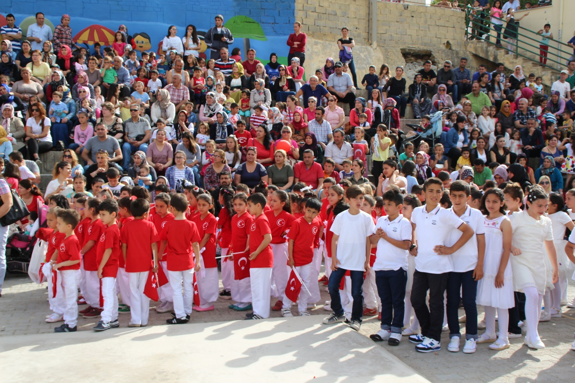

Slide 8
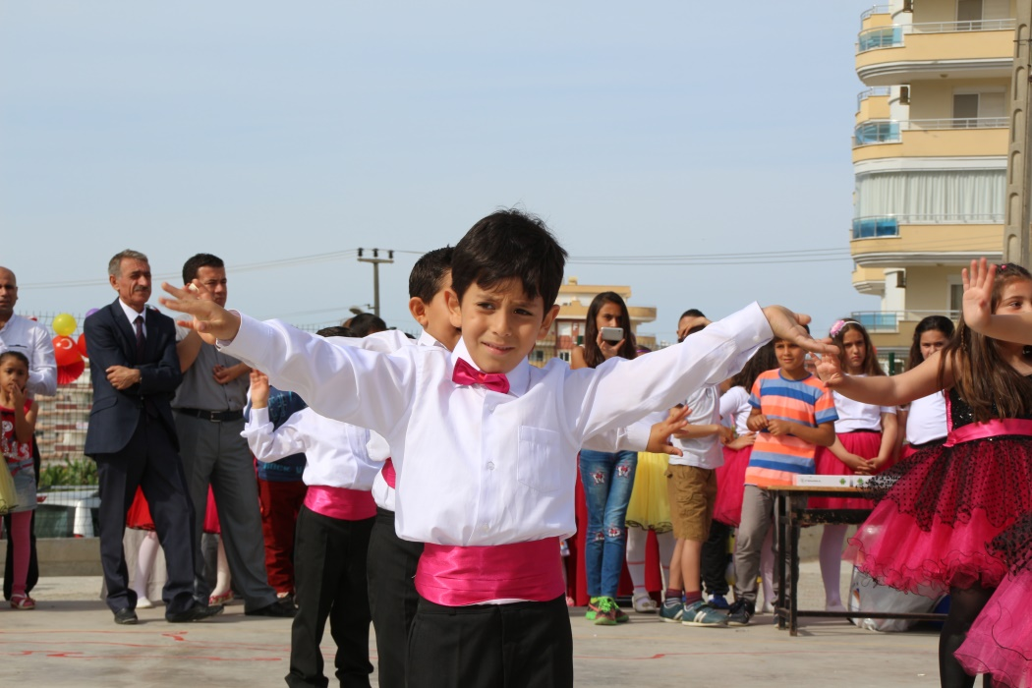

Slide 9
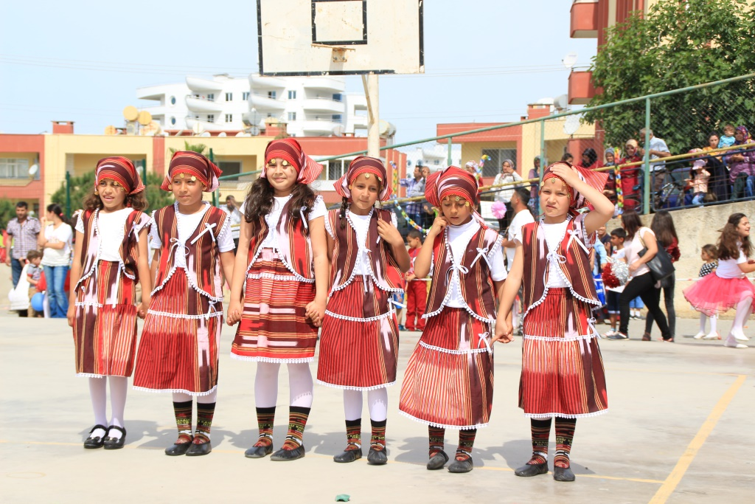

Slide 10
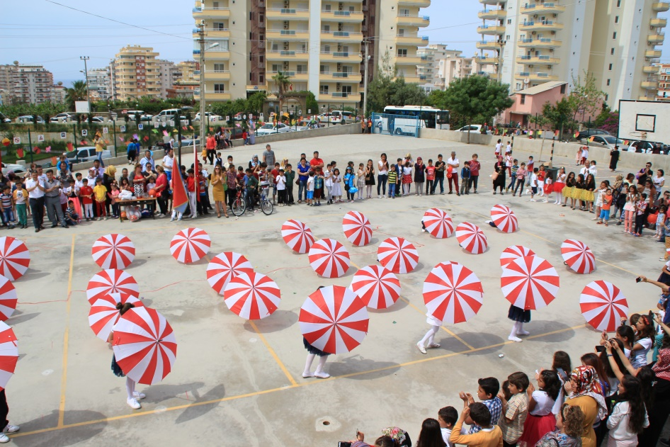

Slide 11
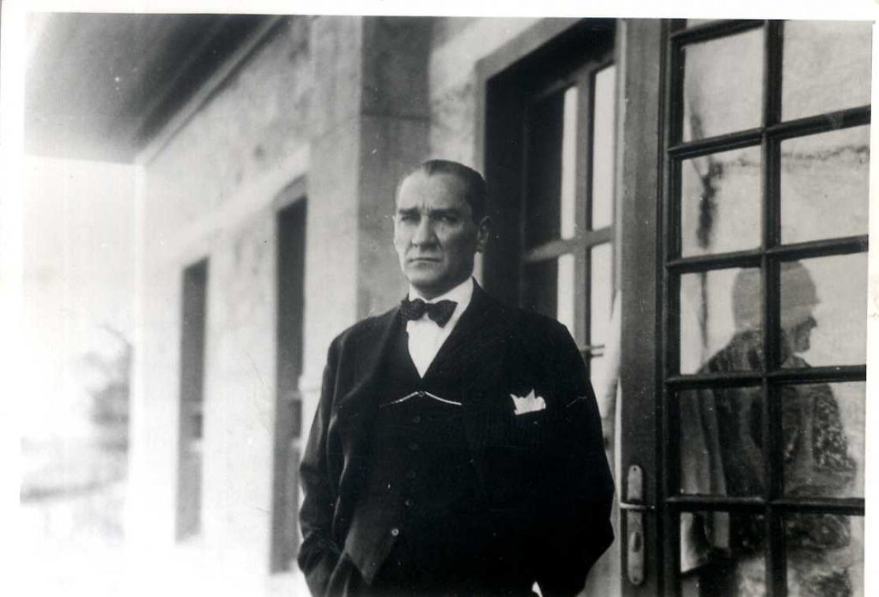
10 November Commemoration Day of Great Leader Mustafa Kemal Atatürk
We will commemorate the founder of Turkish Republic, our great leader Mustafa Kemal Atatürk on the 83th anniversary of his death.

Slide 12
