Slide 1
STEAM
TURKISH COUSINE

Slide 2
Turkish Kebabs (Kebabs Are More Than Just Meat on Sticks)
Are you a fan of shish kebab? Turkish cuisine is known not only for introducing the world to shish kebab but for a variety of delicious grilled meats and kebabs.
In Turkish cuisine, "şiş" (SHEESH') refers to the metal skewer and "kebap" means "roasted meat dish." Chunks of marinated lamb or beef are placed on the skewers, usually without vegetables, and turned over a coal fire until they're done. Some of the world's best and and most flavorful kebabs come from Turkey's southeastern provinces, and you can make many of these dishes at home.

Slide 3
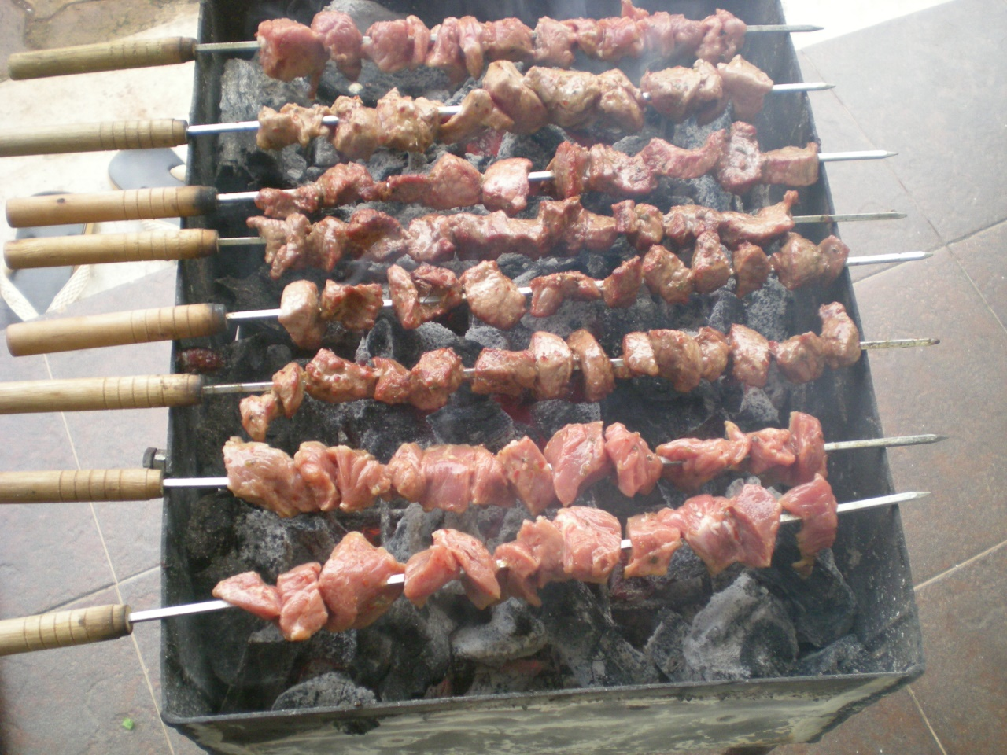
For a classic kebab that's easy to make, you can't go wrong with beef shish kebabs. This recipe calls for the meat to be marinated overnight and cooked on a charcoal grill. If you'd like grilled vegetables with your kebabs, grill them on separate skewers.

Slide 4
Adana Kebab (Ground Lamb Kebab)
Anita SchecterAdana kebab (ah-DAH'-nah keh-BOB'-uh) is the signature dish named after one of Turkey's most famous kebab cities, Adana. This dish is made with ground beef or lamb kneaded together with onion, garlic, and Turkish spices, then packed by hand around large, flat metal skewers.
When the kebabs are placed on the grill, the fat drips from the meat causing it to bind together. It forms a long, hollow tube of cooked meat once the skewer is removed. Adana is usually served with grilled vegetables like hot green chili peppers, onions, and tomatoes, and a hearty bulgur and vegetable pilaf.

Slide 5
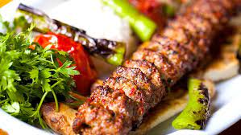

Slide 6
ISKENDER KEBAB
Iskender kebab (iss-ken-DEYR' keh-BOB'-uh), another popular kebab dish from Bursa, is named after Iskender Efendi himself. Crispy shavings of döner are laid upon a loaf of tender, flat pide bread, similar to pita, that's been cut into small squares.
The entire dish is doused with melted butter, creamy yogurt, and a tangy tomato sauce. Authentic Iskender kebab is still served in Bursa, as well as across Turkey in a chain of restaurants named after Iskender Efendi.

Slide 7
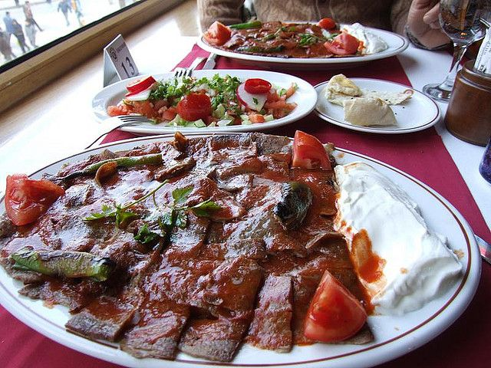

Slide 8
KISIR
If you're a fan of Middle Eastern tabbouleh and other dishes made with bulgur, you'll love this classic Turkish recipe for cold bulgur and a vegetable salad called kısır (kus-UHR').
Bulgur, sometimes referred to as cracked wheat, is a staple in Turkish pantries and is one of the most common ingredients in Turkish cooking. It's used to make side dishes like bulgur pilaf, added to thicken soups, kneaded into meatballs and, one of my favorites, included in cold salads like bulgur and fresh herb salad and kısır.
One of the Most Popular Dishes
Kısır salad is by far one of the most popular dishes in Turkish cuisine. Every home cook makes a variation of kısır, and you'll also find it in many restaurants serving casual, homestyle Turkish fare. What makes kısır so popular? For one, it contains fresh, nutritious and inexpensive ingredients. It's also very easy to make, and a little bit goes a long, long way. Kısır is great for entertaining—its flavor gets better as the salad rests so that you can make it well beforehand. It will keep very well in the refrigerator for several days.
You'll recognize kısır as soon as you see it. The pepper paste gives the bulgur a lovely orange hue, and the mixed vegetables and fresh herbs add festive color. Kısır is most often served, believe it or not, at tea time along with other sweet and savory pastries. But since it complements grilled meats and chicken, it's also perfect as part of a barbecue menu.

Slide 9
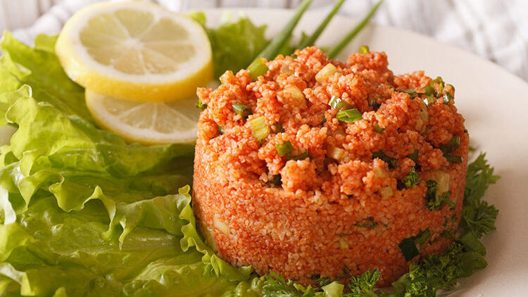
Using Different Vegetables and Herbs Every Turkish household makes kısır with a slightly different mix of vegetables and herbs. Some like it spicy and some like more onions and garlic. The best thing to do is to get creative with ingredients like colored peppers, green onions, crushed nuts, even chopped beets, and pickles. Anything goes as long as it's fresh, colorful and crunchy. You can find pepper paste in most Middle Eastern, Greek or Turkish grocers or on websites selling Turkish ingredients. Another alternative is to finely grate fresh red peppers of your choice and strain out the juice to make your own pepper paste. This recipe calls for lemon juice or pomegranate sour, which is a thick syrup made of 85 percent pomegranate giving it a very concentrated taste. If you want to include this unique ingredient, look for it where Turkish foods are sold.

Slide 10
Köfte: Turkish Grilled Meatballs
In Turkey, grilled meat patties, called köfte (koeuf-TAY'), are a national favorite and the single most popular dish prepared with ground beef, one of the most common ingredients in Turkish cuisine.
Köfte come in all shapes and sizes and feature different mixtures of ground beef, lamb or chicken mixed with spices, bread, and egg before they're grilled, pan-fried, stewed or broiled. There is also a vegetarian version.
In Turkish, köfte is actually a general term that refers to any food shaped by hand into a patty, ball or cylinder. Use of spices, ingredients, and cooking methods vary greatly across the country, making köfte an important example of Turkish regional cuisine.

Slide 11
Ingredients
1 pound ground beef (80% to 85% lean)
1 small onion (grated)
3 slices stale white bread (crusts removed, or 1/3 cup plain breadcrumbs)
1 egg
1 to 2 garlic cloves (finely chopped, or 1 tsp. garlic powder)
1/4 cup chopped fresh Italian parsley
2 tsp. salt
Black pepper to taste

Slide 12
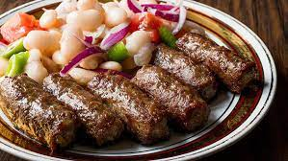
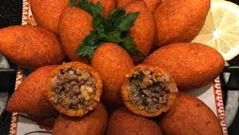
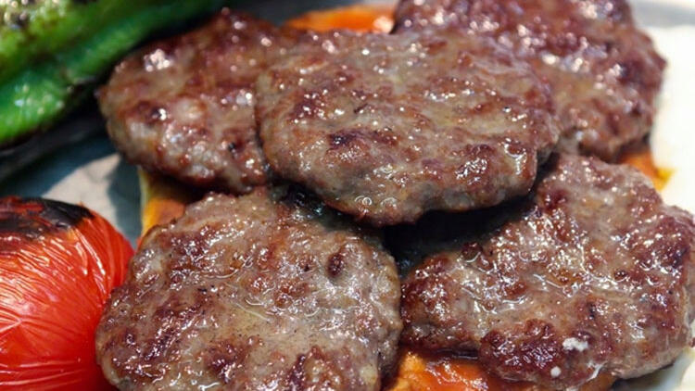

Slide 13
Turkish Noah's Ark Pudding Asure Recipe
There is no set recipe for making Noah's ark pudding. There are hundreds, if not thousands, of variations. You can use the basic recipe below as a guide.
You can adapt the ingredients and according to your taste or what you have on hand. Classic versions of aşure use rose water to flavor the pudding.
We like to add the zest of an orange and a lemon in place of the rose water for a citrusy flavor. Many cooks prefer the pudding plain with no added flavoring.
Whichever way you choose to prepare it, be ready to share your Noah's ark pudding with your neighbors, too. This recipe will make enough to fill a large pot.

Slide 14
Ingredients
3 cups uncooked whole grain wheat or barley
1 1/2 cups canned chickpeas (rinsed and drained)
1 1/2 cups canned navy beans (rinsed and drained)
1/4 cup uncooked rice
3 tablespoon dried currants
3 tablespoon pine nuts
8 dried apricots (cut into chunks)
8 dried figs (cut in chunks)
3 cups of sugar
2 cinnamon sticks
Optional: zest of 1 orange
Optional: zest of 1 lemon
Optional: 2 tablespoons rose water

Slide 15
